Slide 1
Welcome to Gadsden Elementary School!

Slide 2
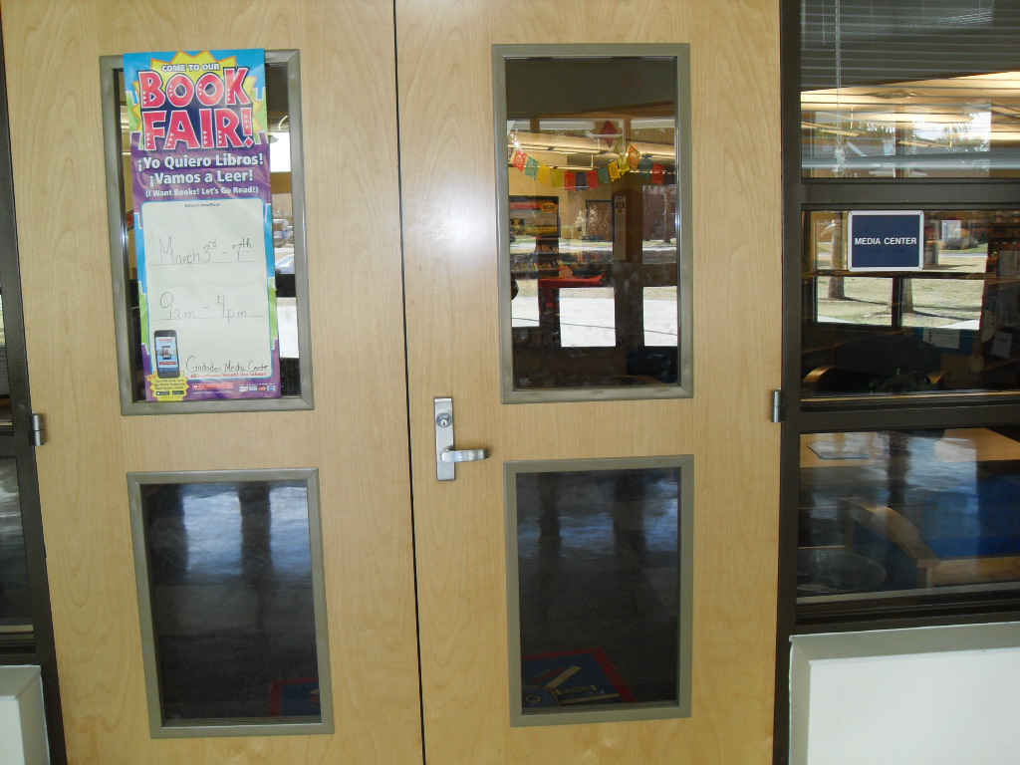

Slide 3
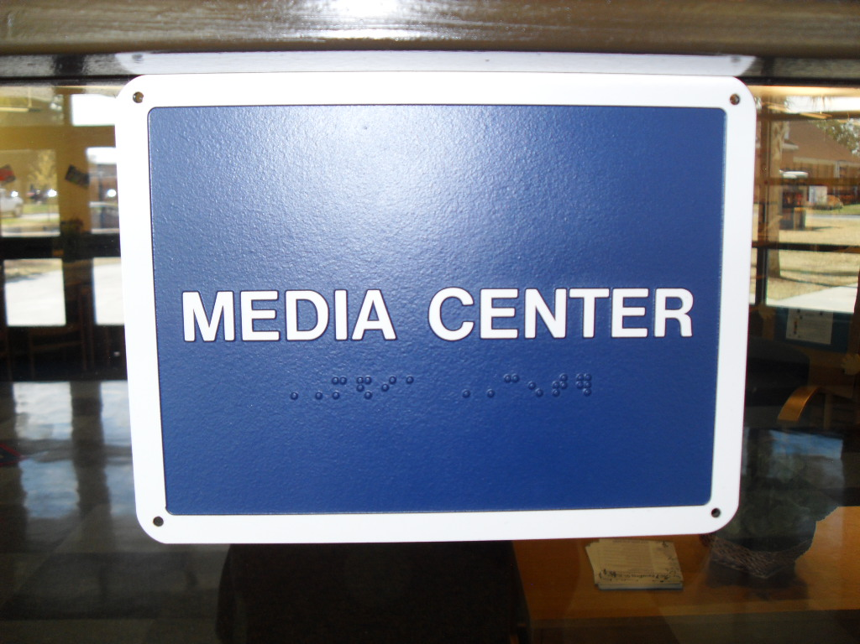

Slide 4
Welcome to the Media Center!
Rules
1. Enter Quietly.
2. Put books you are returning in the book return slot.
3. Select books carefully, put back the ones you don’t want back in the correct place or ask for help.
4. You may have two books checked out at a time.
5. Take care of the books you check out and enjoy!

Slide 5
How to Find What You Need
The following slide shows you the layout of the media center.
Books are arranged by the Dewey Decimal Classification system. Non-fiction books are against the wall. They have a label on each shelf to help you find what you need. These books have a number on the spine of each book.
Fiction and Easy Readers are on the bookshelves in the center. They have an “E” for Easy Reader and then the author’s last name below that on the spine. Fiction books have an “F” and the author’s last name below that on their spines.

Slide 6
Media Office
Small Group Offices/Workspace …………………………………………Restrooms
Back Door
Promethean Board
Teacher
Workroom
Small Group Learning
Parent Center
Student Learning
Computers
Circulation Desk
Reference
Small Group
Learning
Front Door
Easy Fiction
Storytime
Corner
Comfortable Seating With
Small Coffee Table
Easy Fiction
Fiction
Magazines
Nonfiction

Slide 7
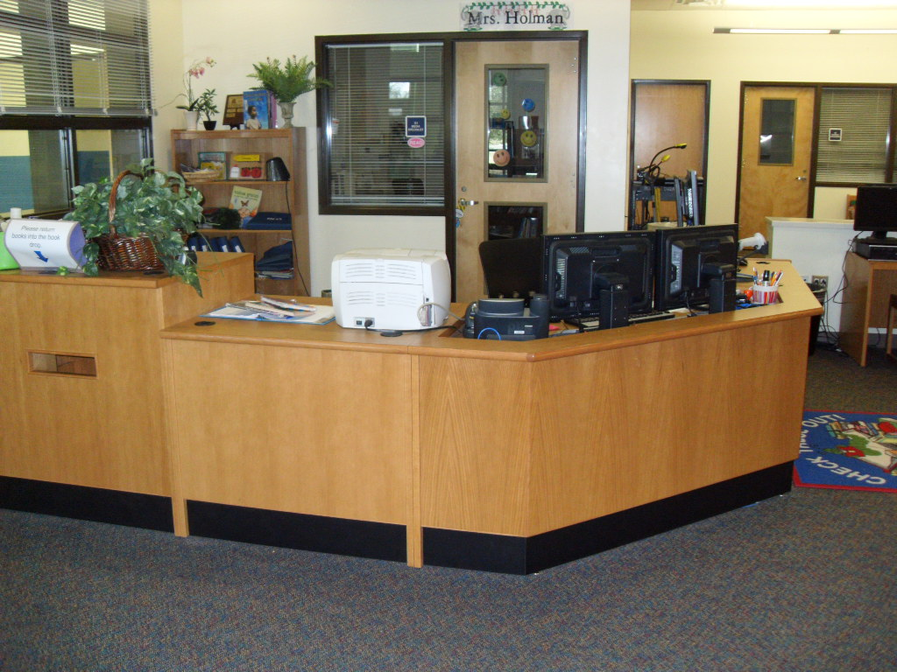

Slide 8
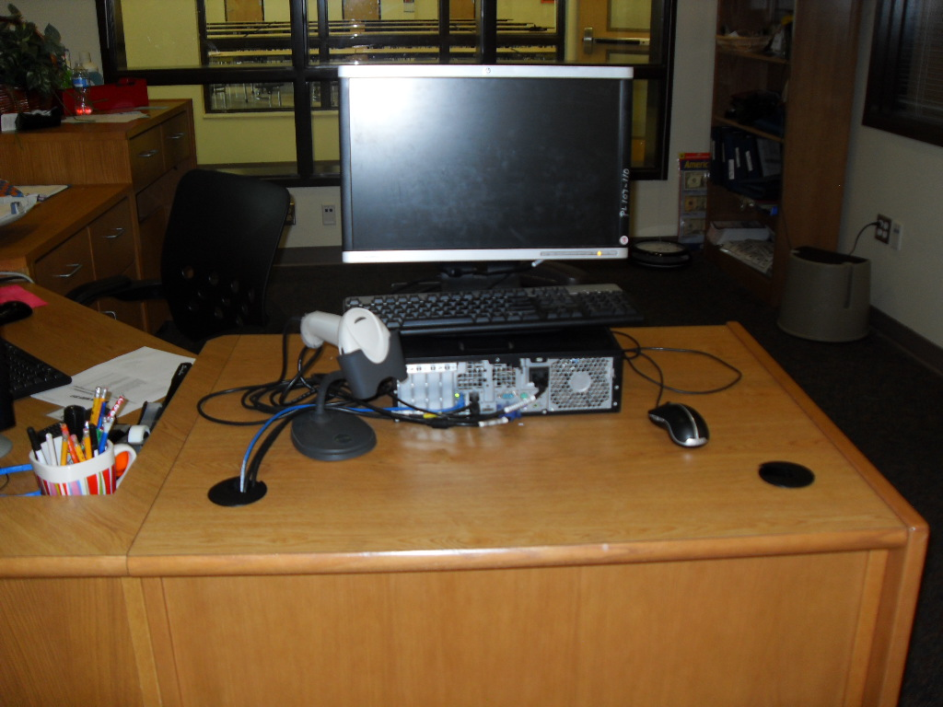

Slide 9
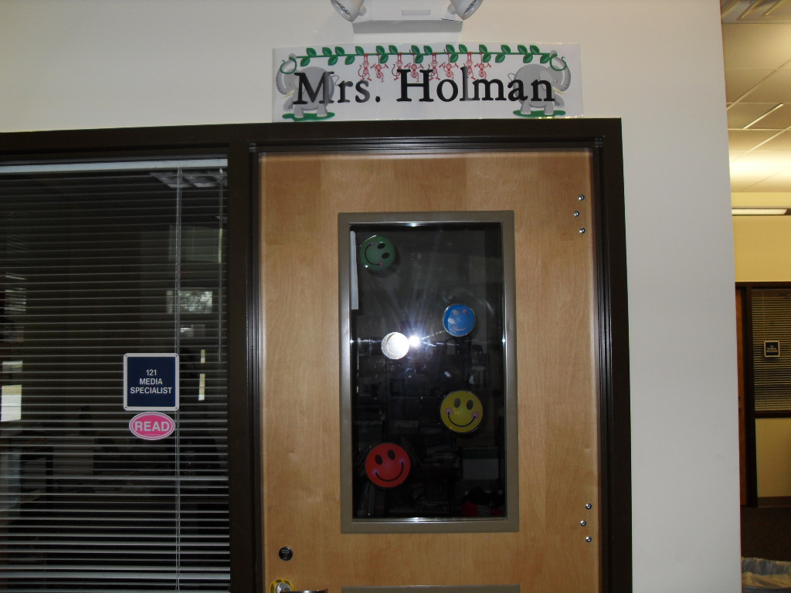

Slide 10
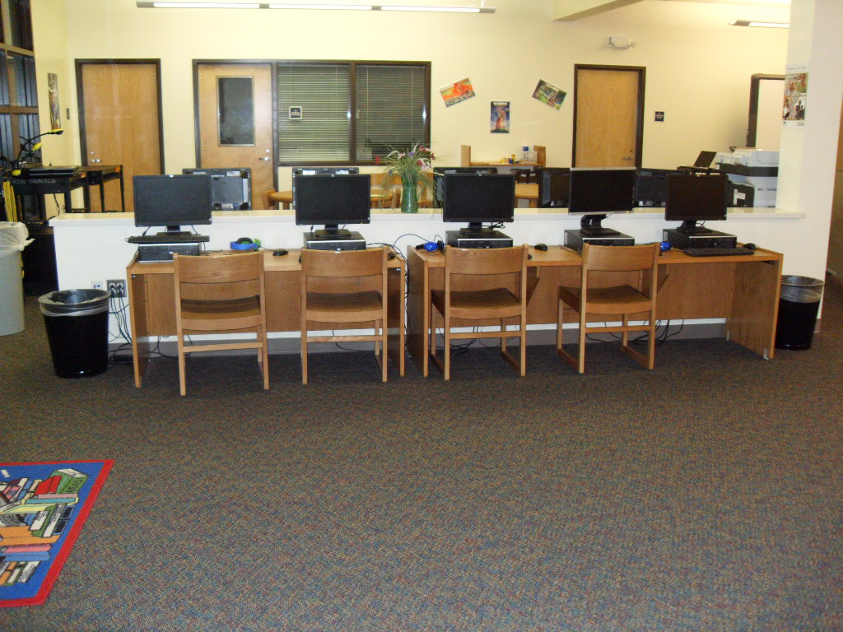

Slide 11
Computer Rules
Computers are for school related research and learning.
Only go to school approved websites.
Login using student14 as the user name and ges15 as the password.
Treat computers and headphones with care.
Log off and push chair in when finished using computer.
Make sure to leave the area clean and make sure you have all of your belongings when you leave.

Slide 12
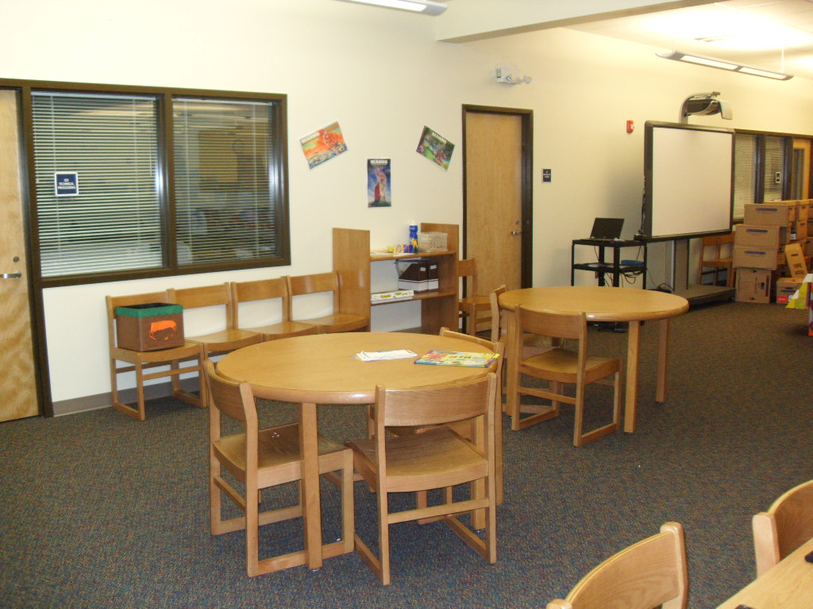

Slide 13
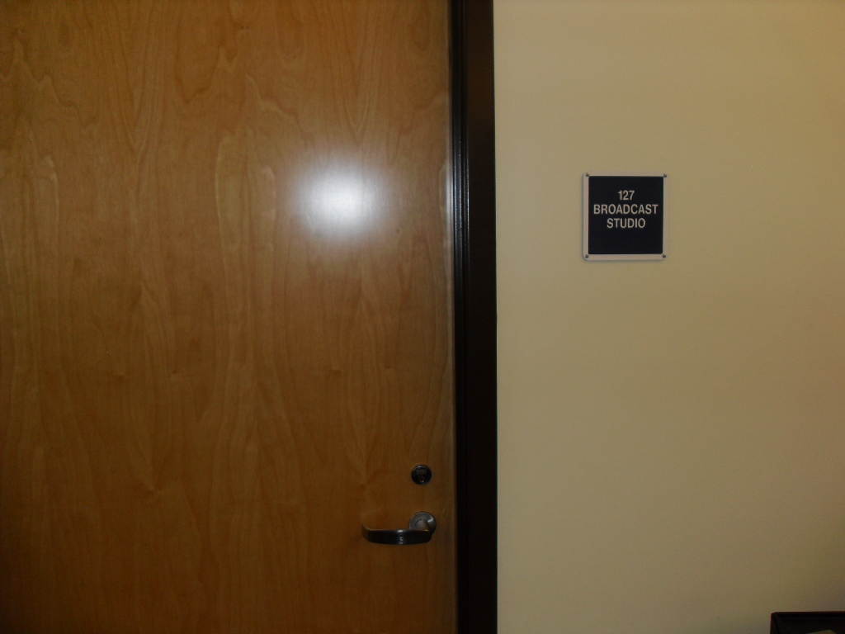

Slide 14
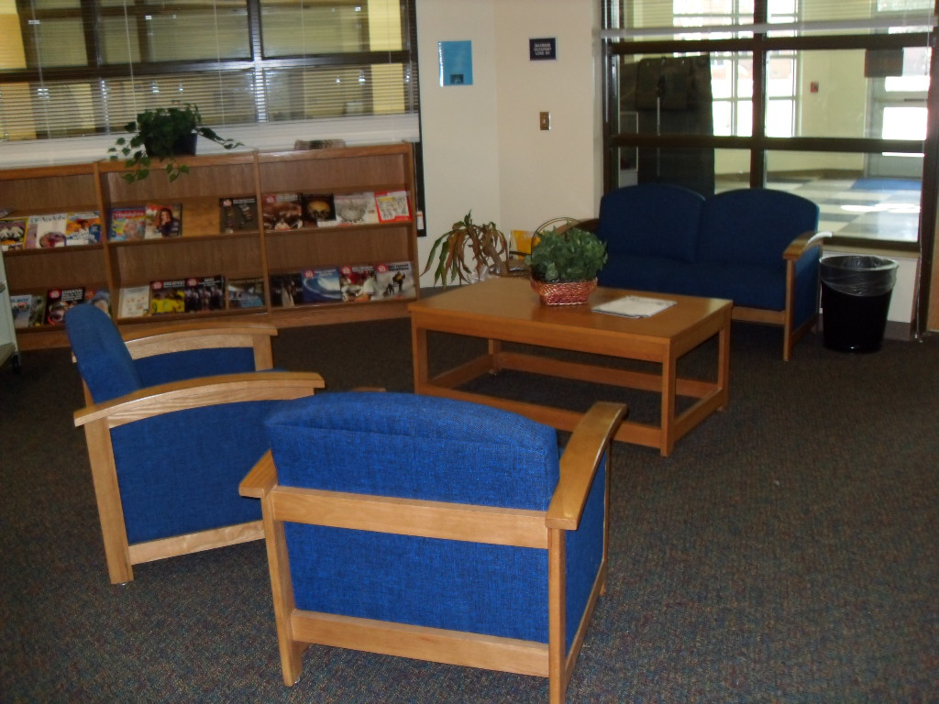

Slide 15
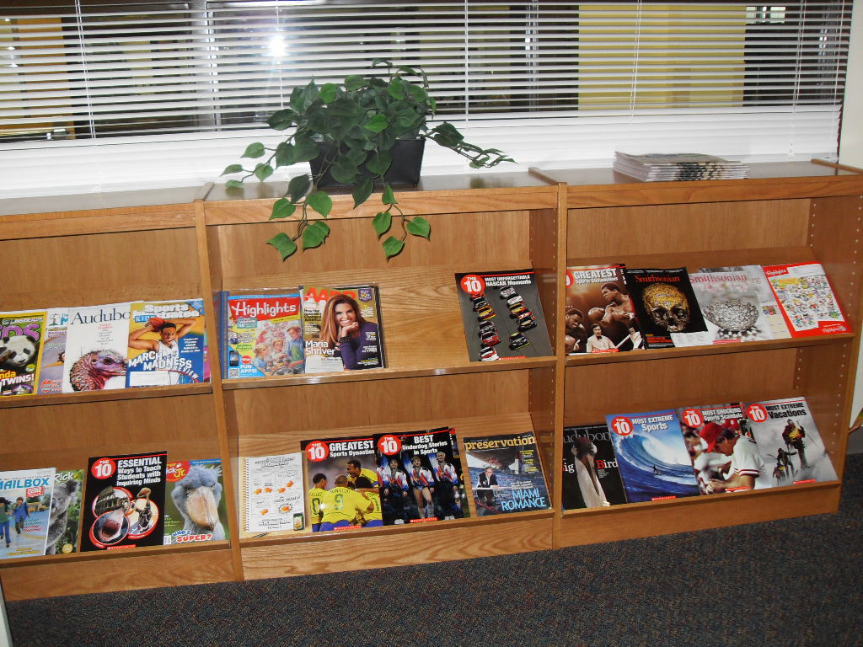

Slide 16
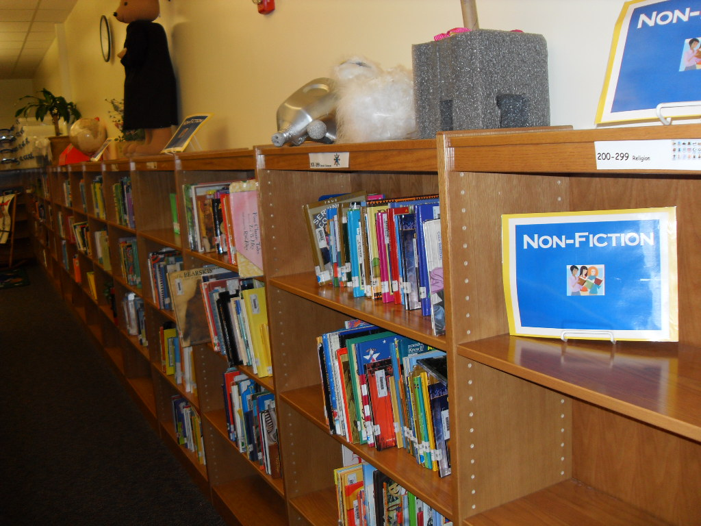

Slide 17
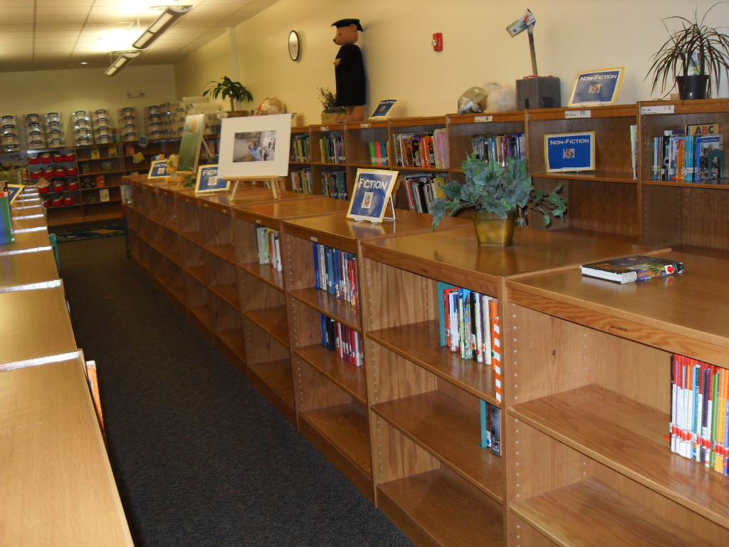

Slide 18
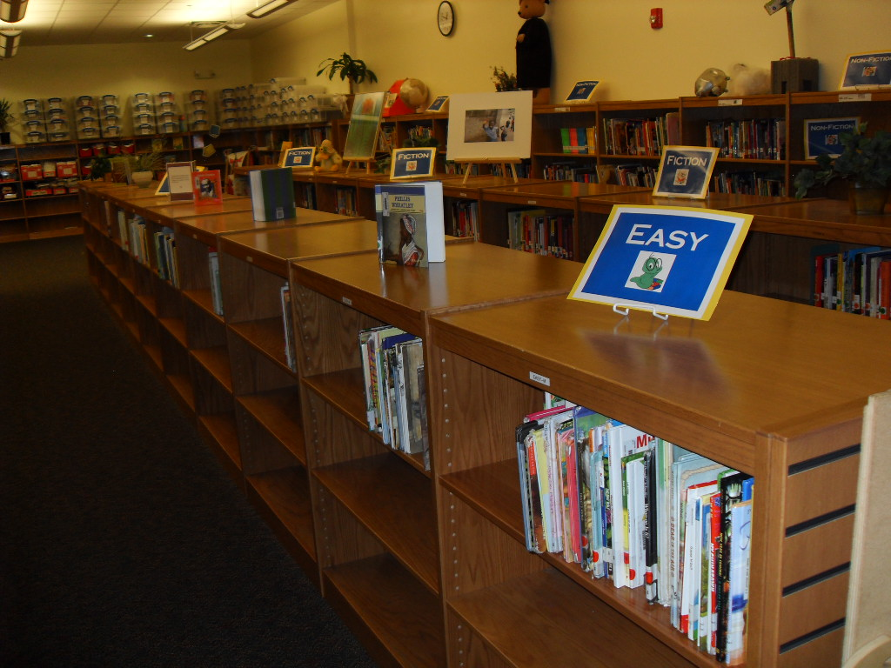

Slide 19
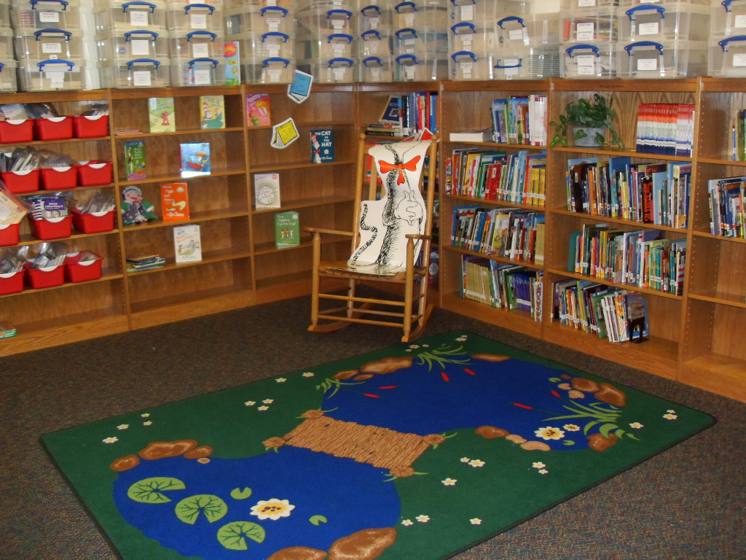

Slide 20
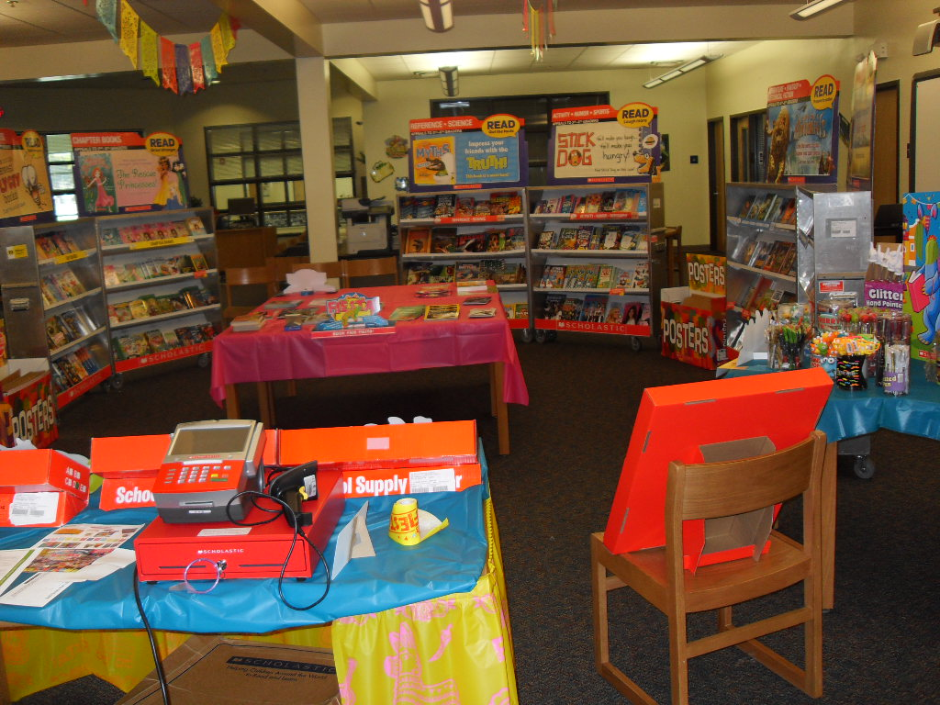

Slide 21
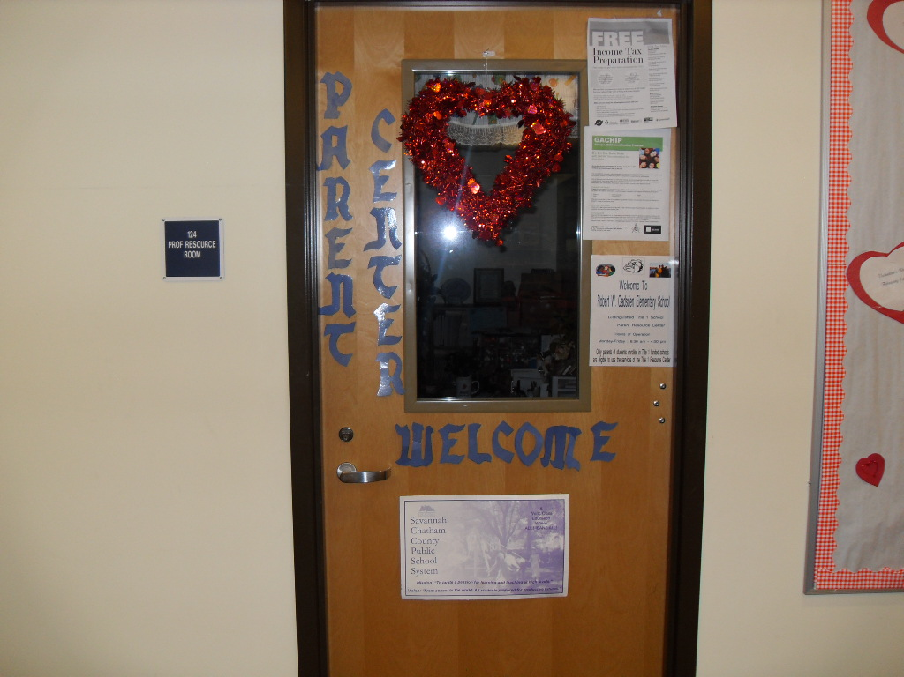

Slide 22
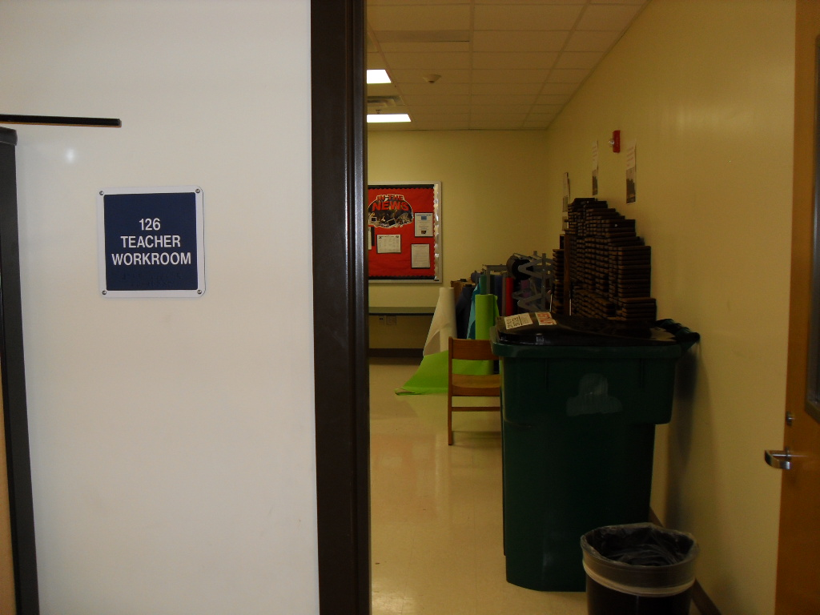

Slide 23
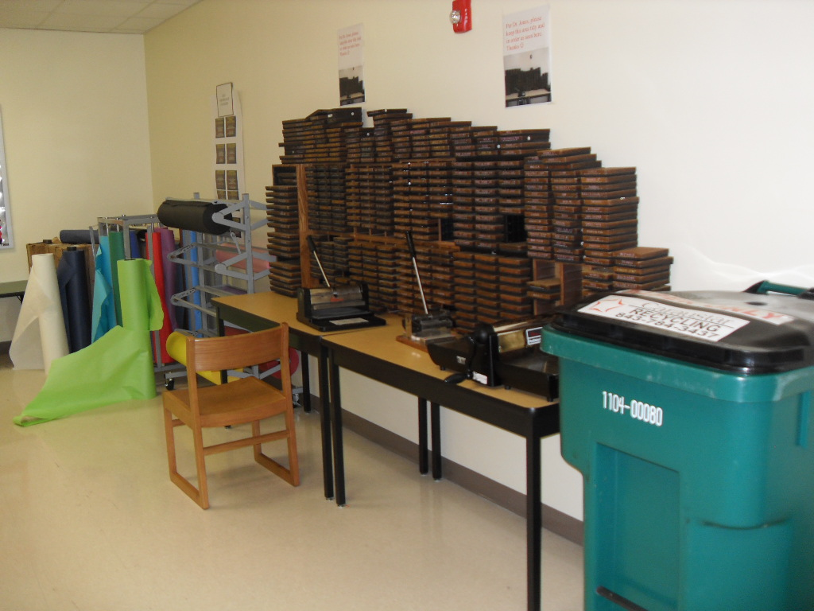

Slide 24
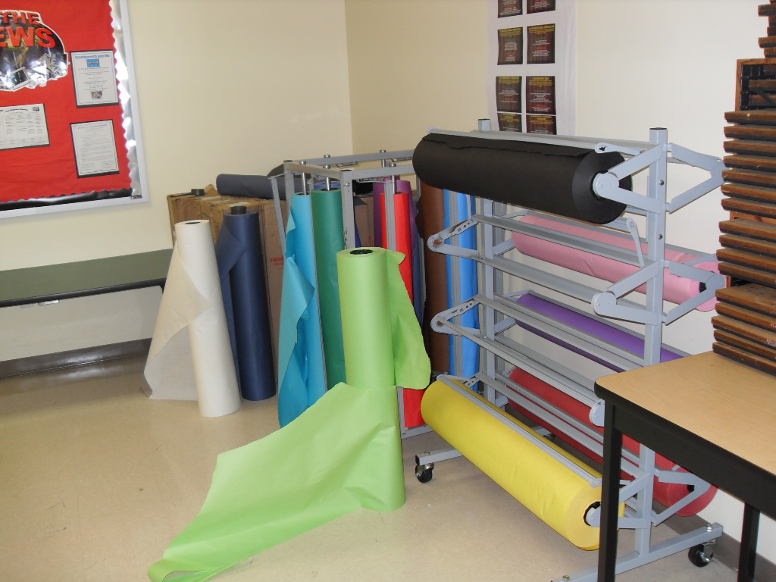

Slide 25
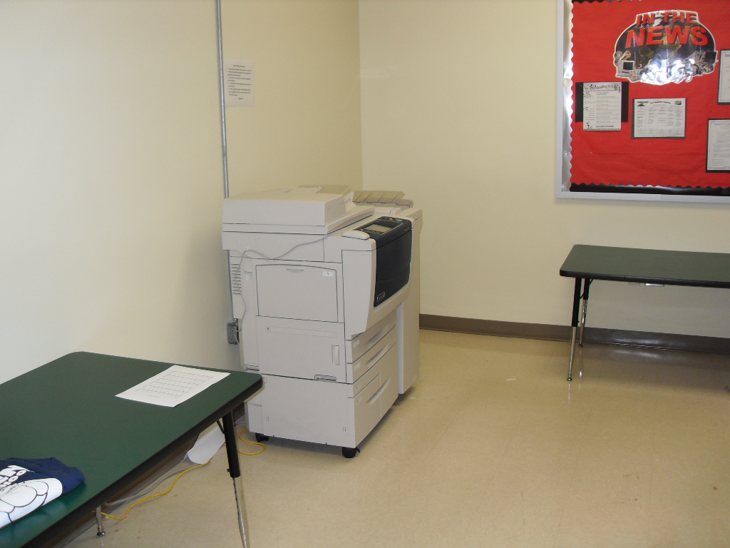

Slide 26
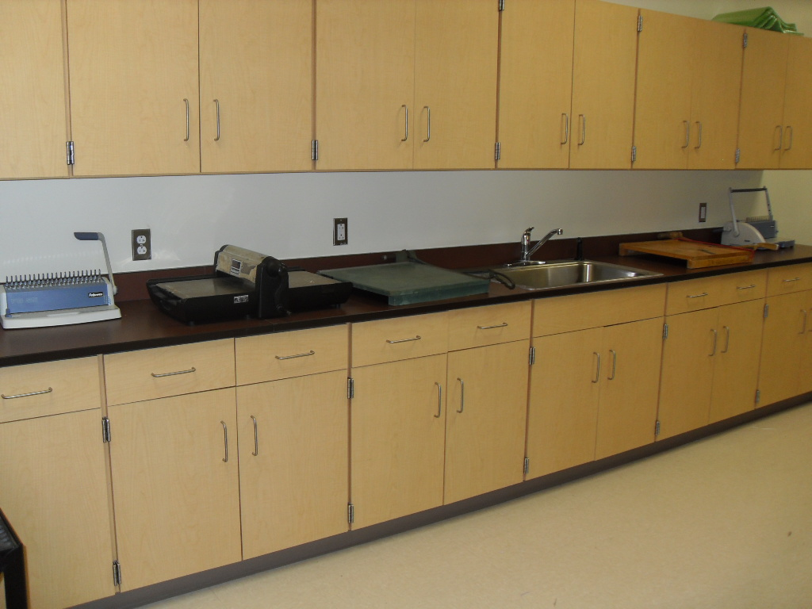

Slide 27
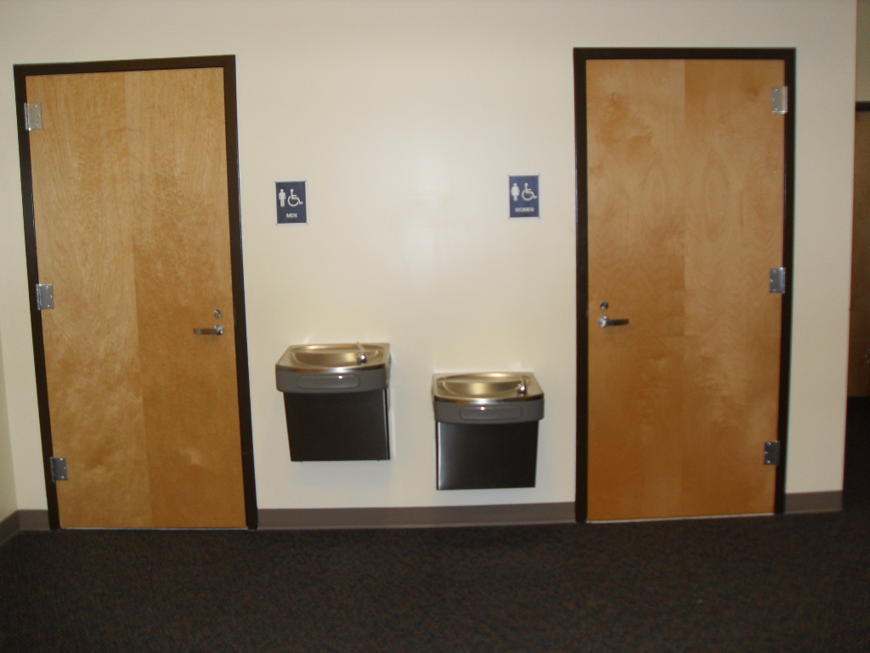

Slide 28
Thanks for viewing this orientation!
We hope to see you back in the Media Center soon!

