Slide 1
How to Use Destiny to Find Books on a Certain Lexile Reading Level
A Guide for Teachers, Students, Parents and Volunteers
By Susan Byers

Slide 2
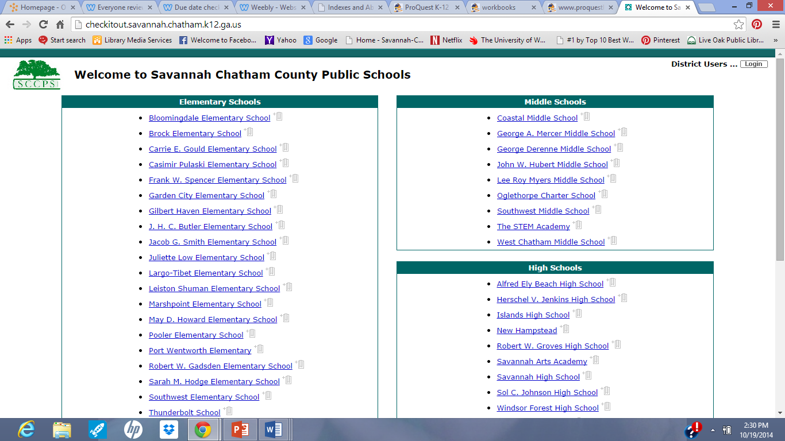
First, gain access to Destiny, either at the media center, any computer in the school or even at home. Website is http://checkitout.savannah.chatham.k12.ga.us/ Click on Robert W. Gadsden.

Slide 3
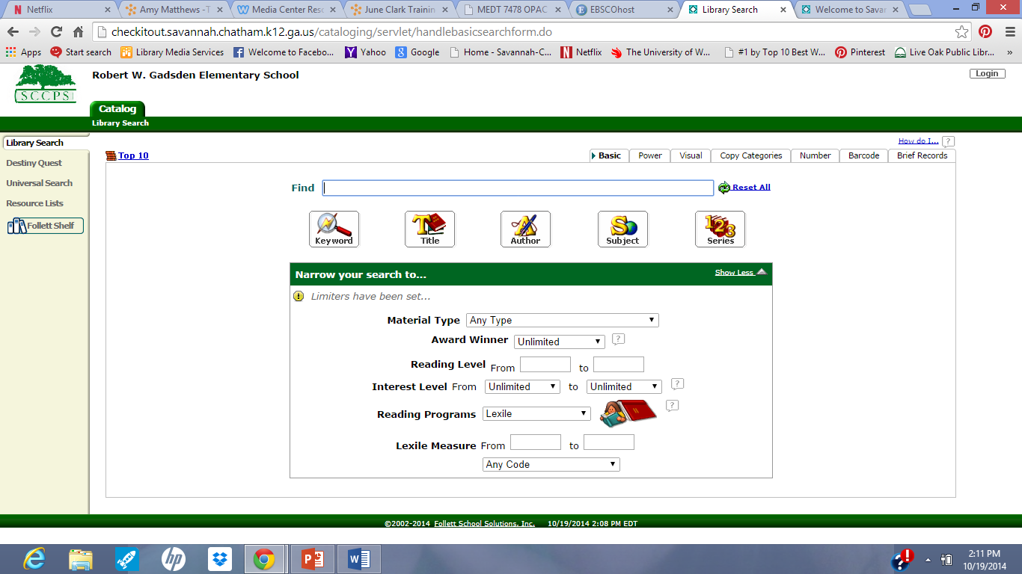
Click on the Reading Programs Drop Down Arrow and select “Lexile.”
This will bring up new boxes to type in Lexile Measure “From” and “To.”

Slide 4
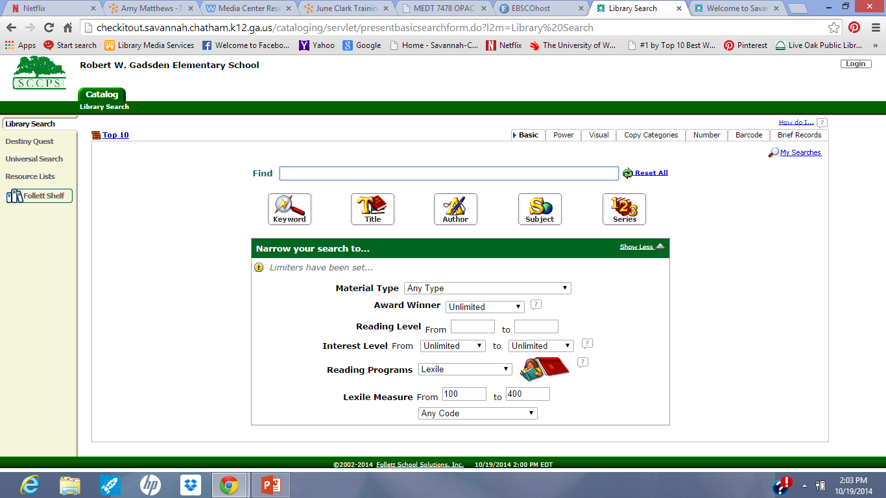
Type in a lexile range in the “To” and “From” boxes.

Slide 5
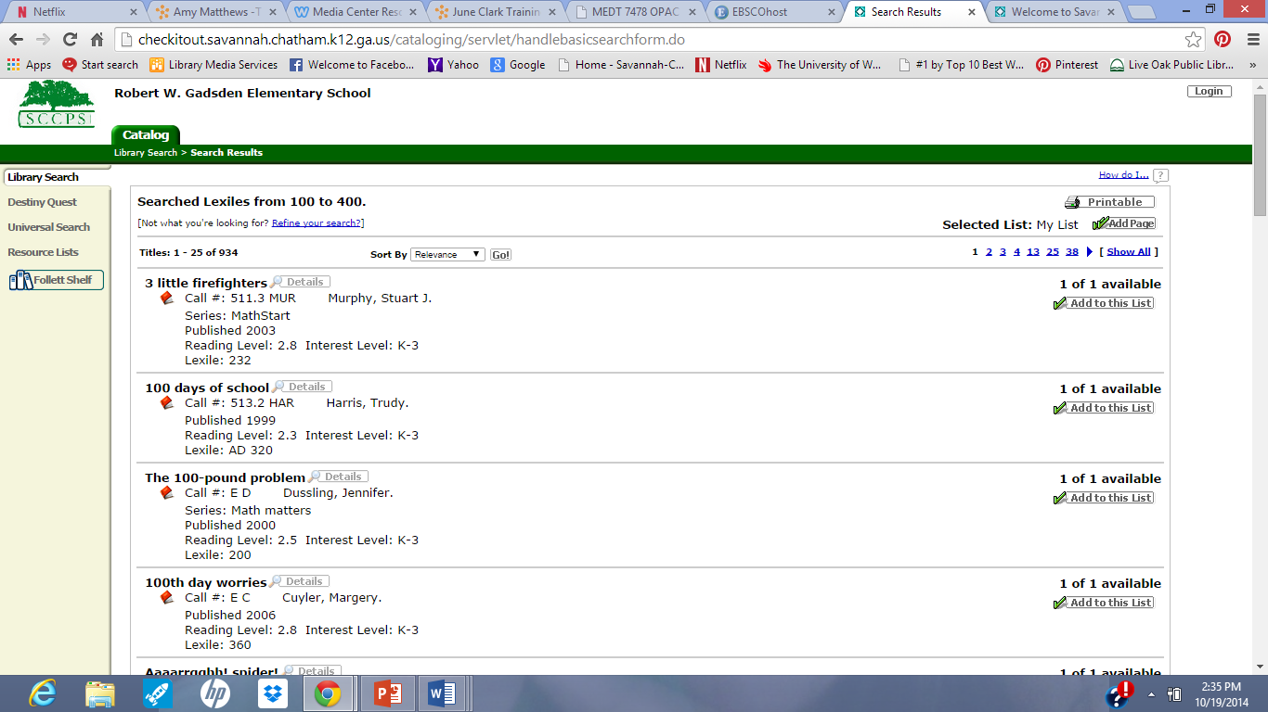
Materials that meet that criteria will come up in a printable list.

